Slide 1
AVERAGE COFFEE CONSUMPTION
Arman İbrişim 32014

Slide 2




DATA Set

Slide 3
My Hypothesis
My step count increases according to the average
coffee consumption
My step coffee consumption increases according to
exam dates

Slide 5
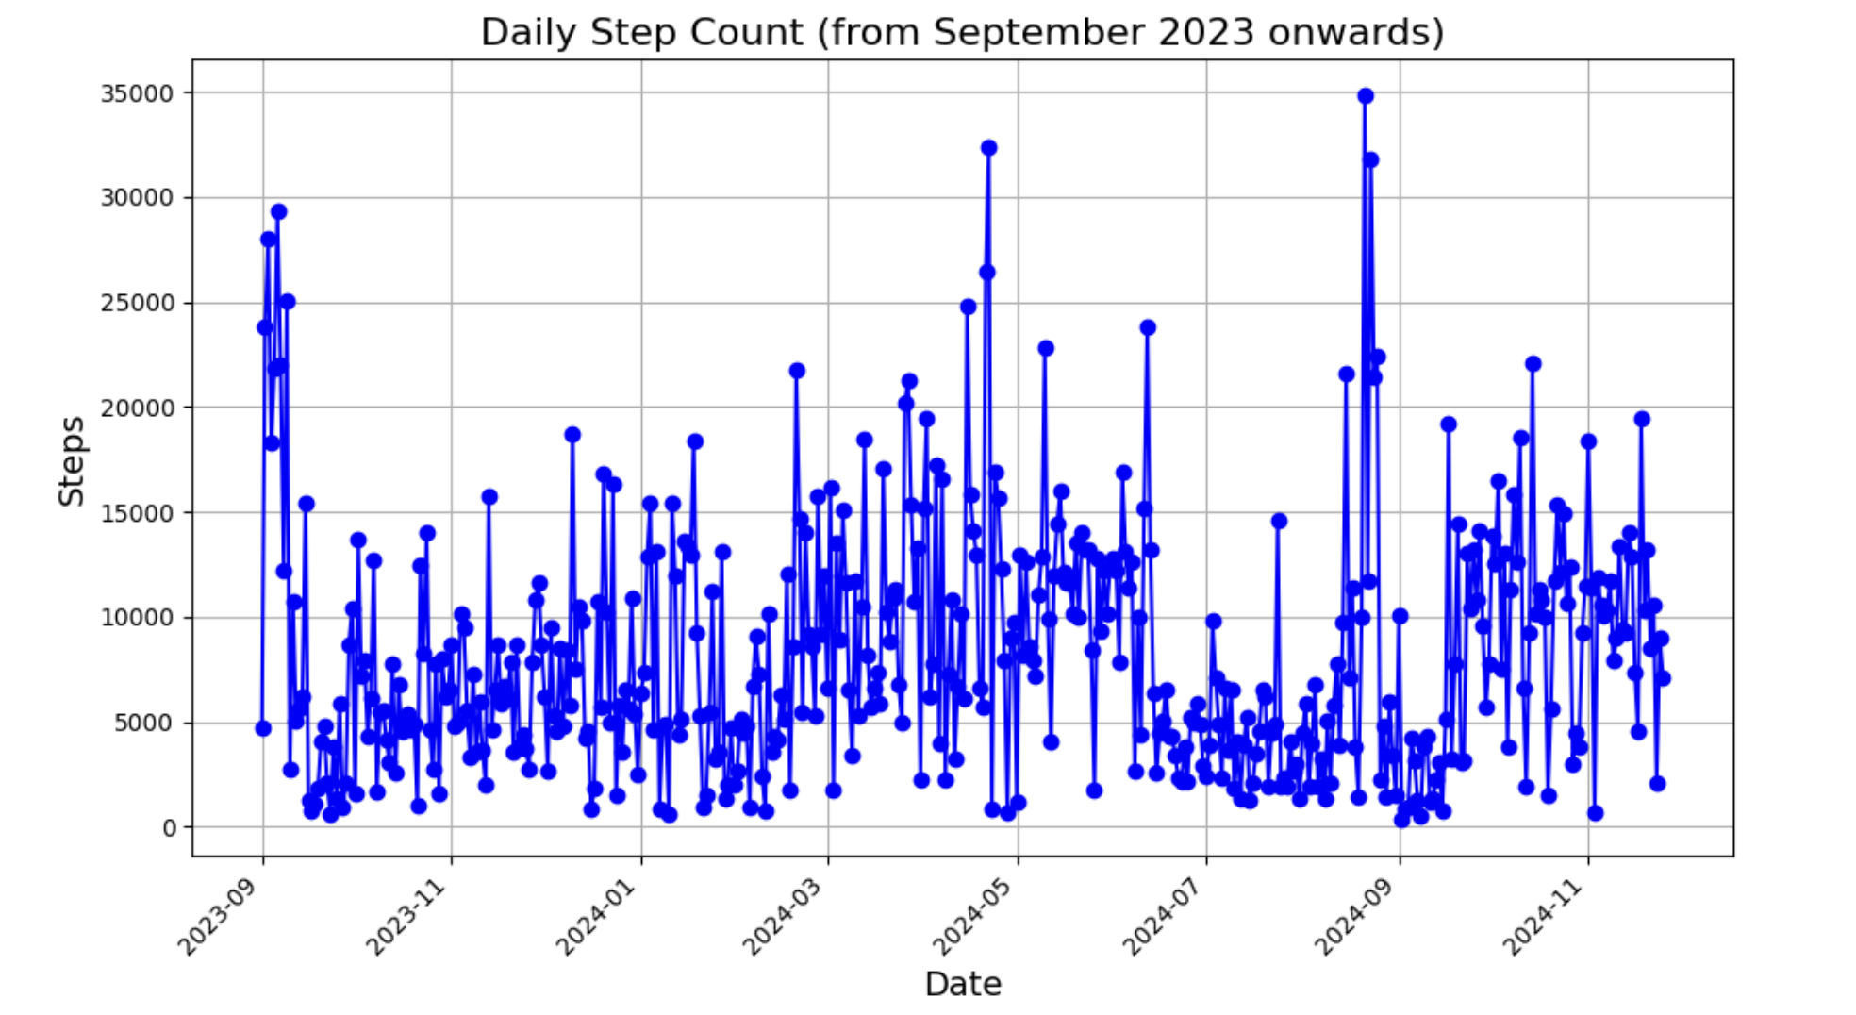
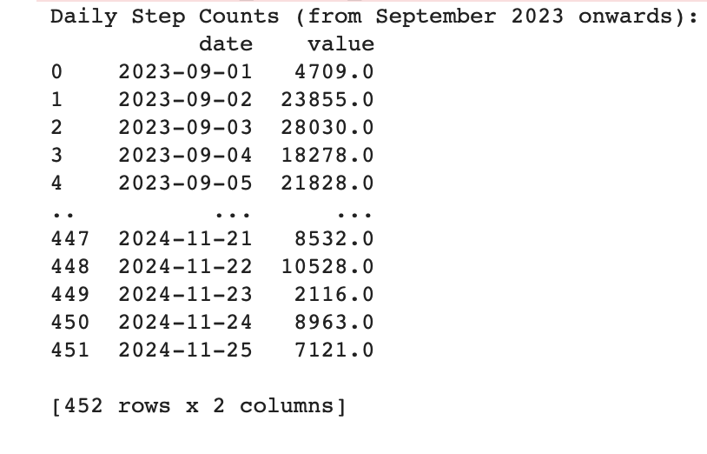
First, I convert the .xml file which taken from Apple Health App to .csv file. Then, I started to explore the data.

Slide 6
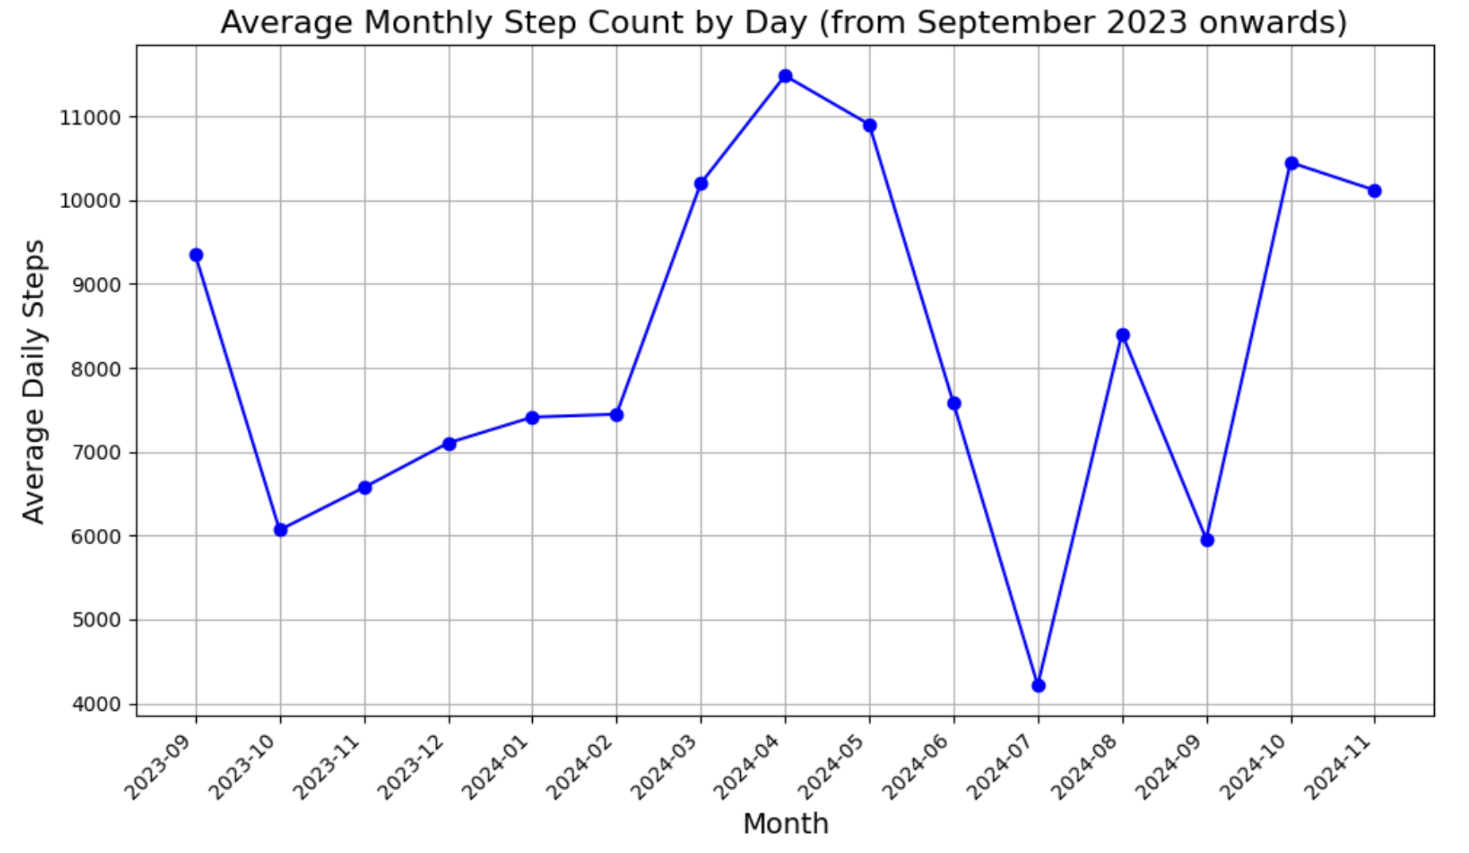
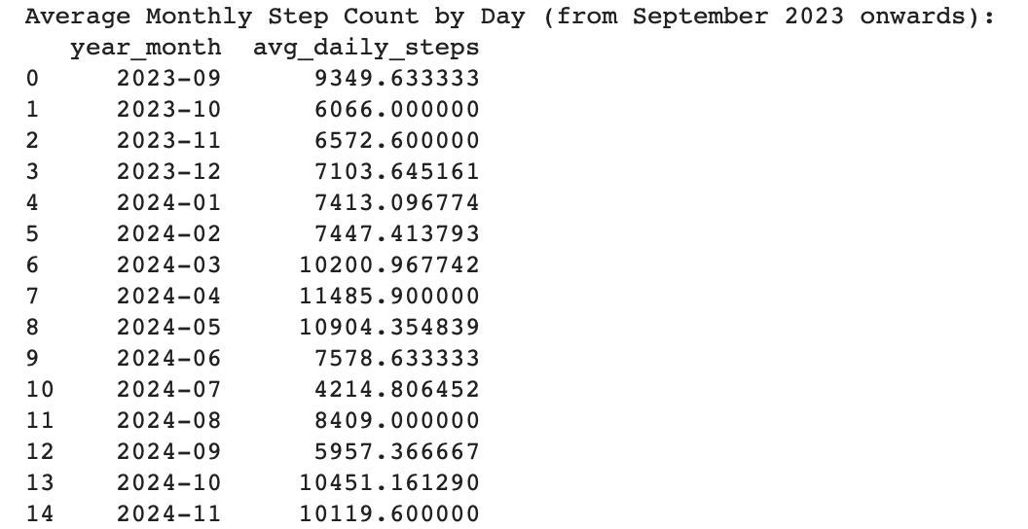
Since the daily data is not a good way to understand my behavior, I also calculated monthly average.
It doesn’t look like there is a trend. Maybe
the part from 2023-10 to 2024-02 could be.
But in general, it is not possible to say there
is a trend.

Slide 8
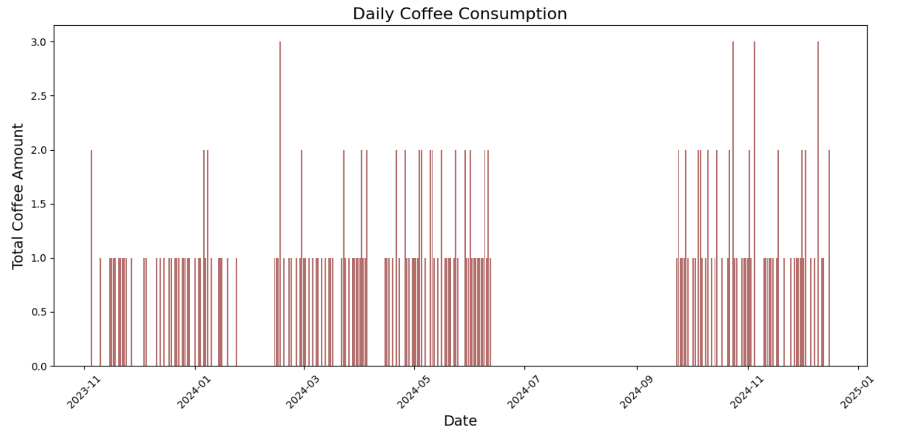
Then, I started to explore my coffee consumption data.
In this graph, it can be seen that my coffee consumption amount day by day. It can be said that some specific days I consumed up to 3 coffee per day. But most of the time, I consumed only 1 coffee.

Slide 9
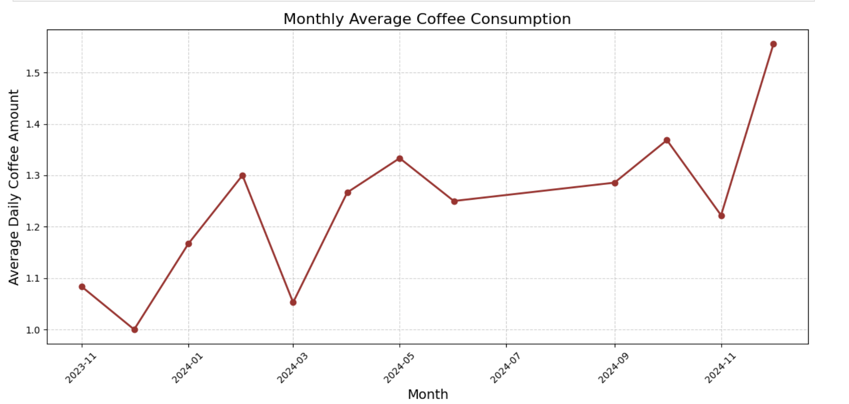
Let’s also plot the monthly average
Again, there seems to be no trend. But, it is obvious that, I don’t consume too much coffee in average.

Slide 10
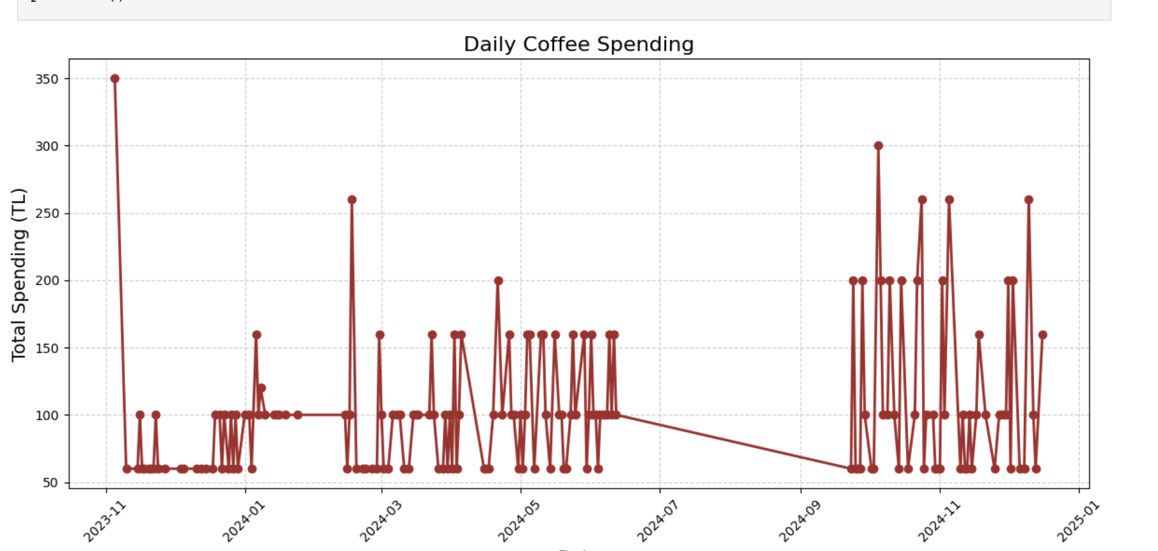
While I was writing the codes, the following came to my mind: The cost of a single coffee differs from place to place. So, I also calculated the spendings to coffee.

Slide 11
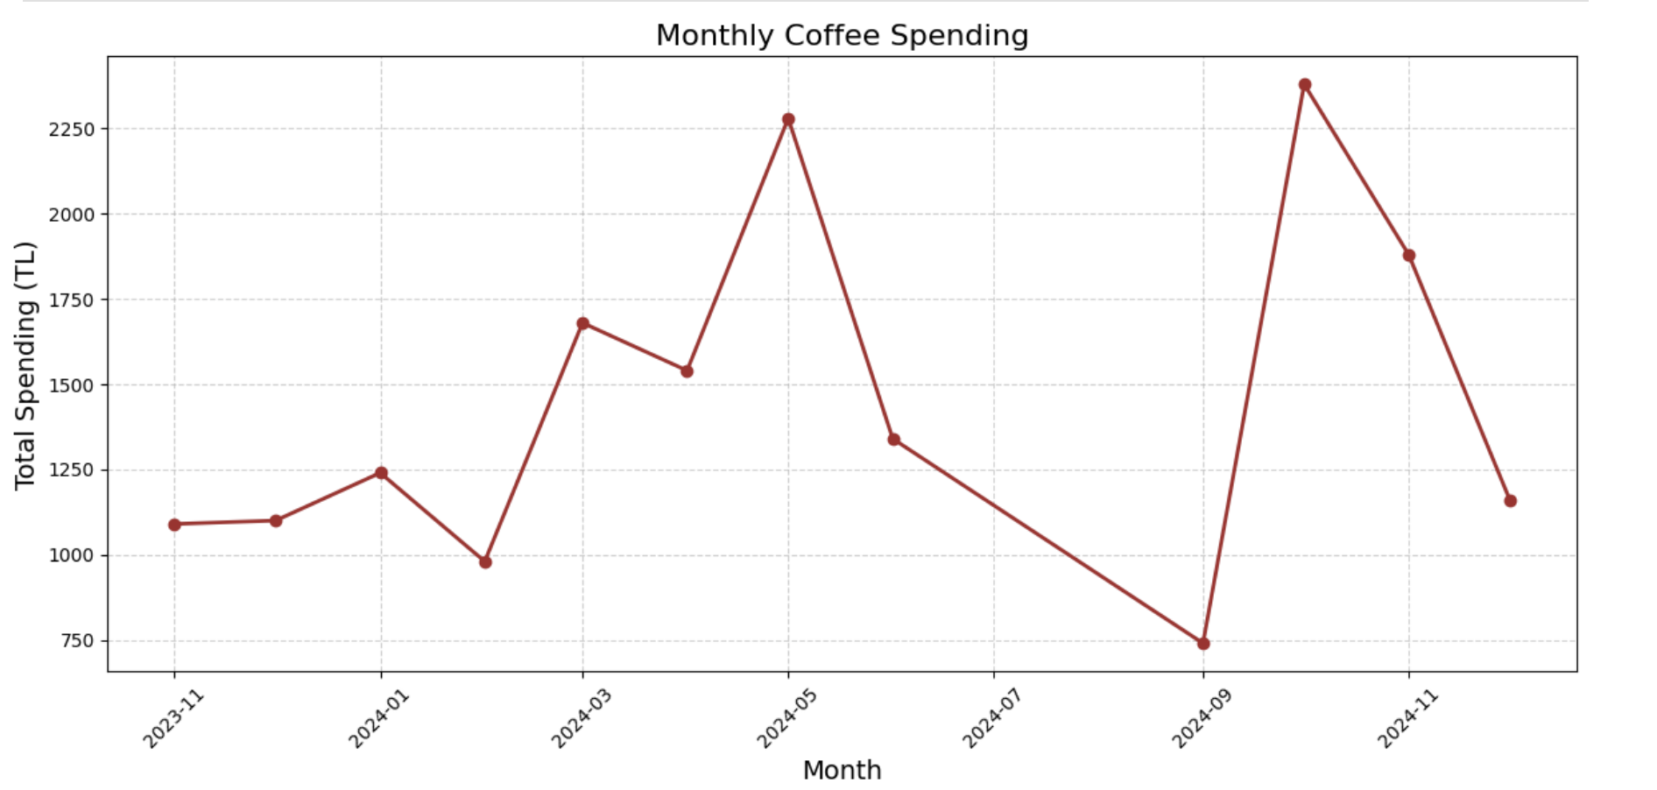
This is the monthly average of the spendings

Slide 12
Surprisingly, there are some important difference between the monthly average coffee consumption and monthly coffee spending. For some months, although my average consumption decreased, my spendings weren’t decreased, instead they were increased!

Slide 13
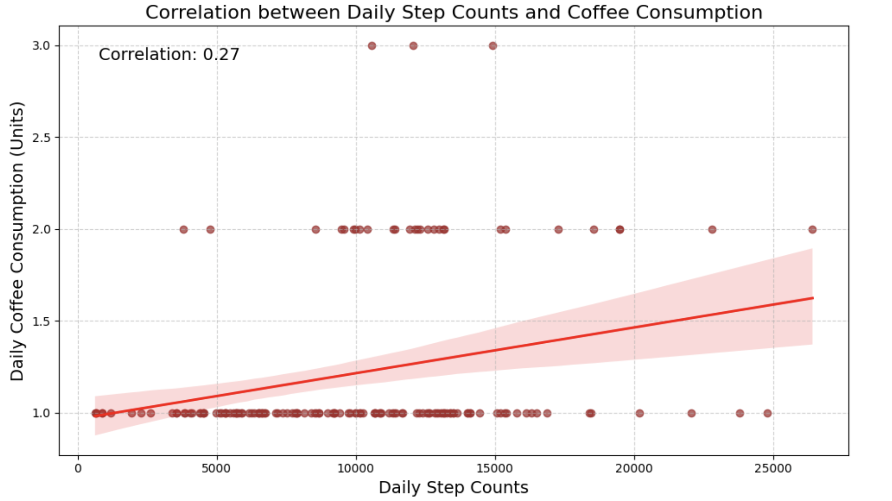
Let’s move back to our topic…
Although, it is not a very solid relation, there is a positive correlation between my daily step count and coffee consumption. But since the correlation is very low, we have to check it with Hypothesis testing methods.

Slide 14
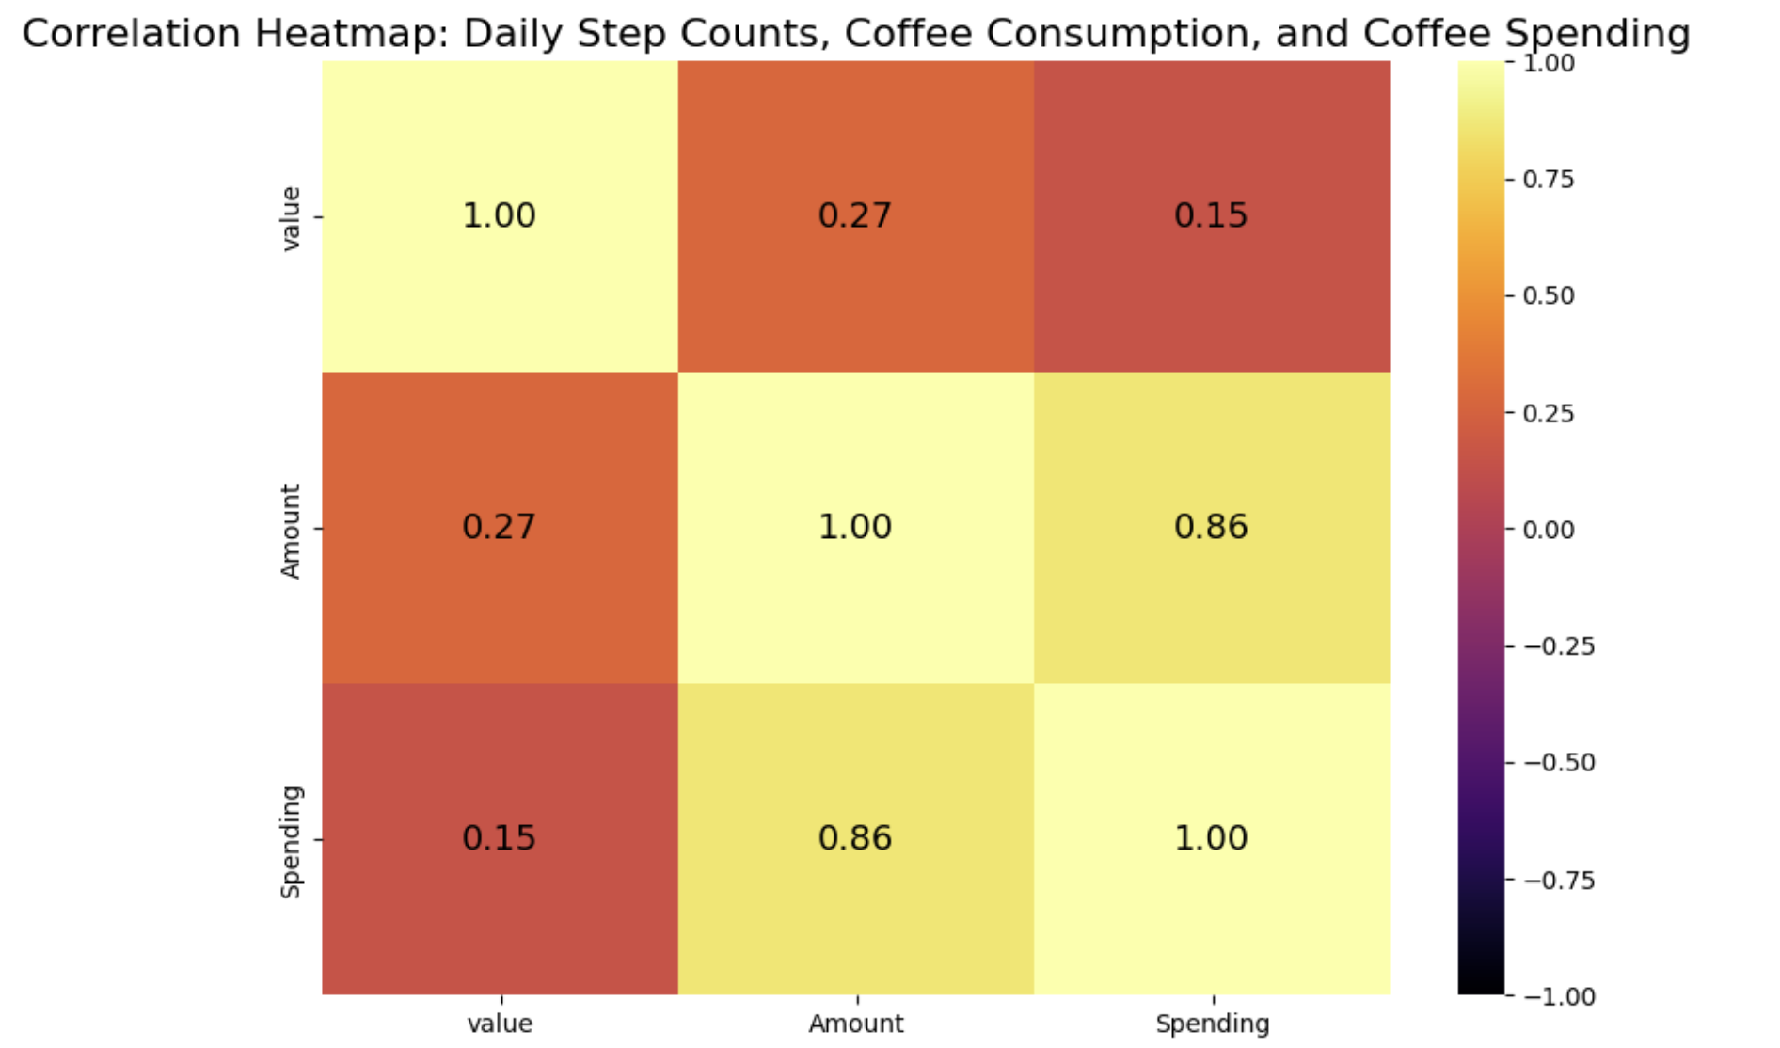

Slide 16
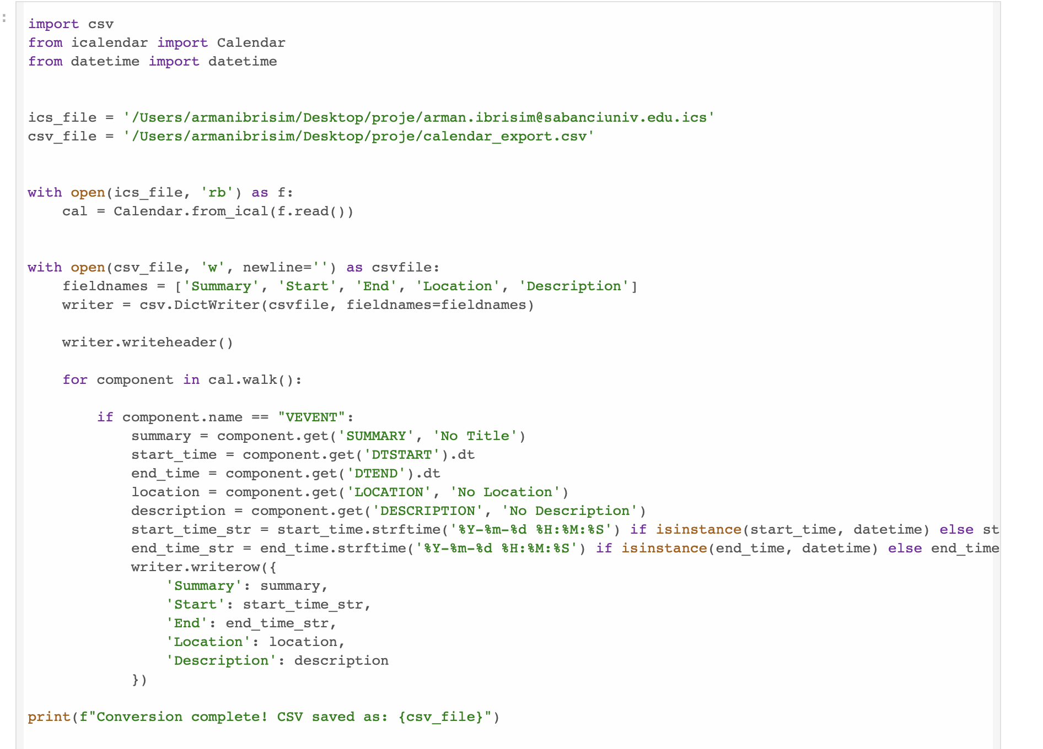
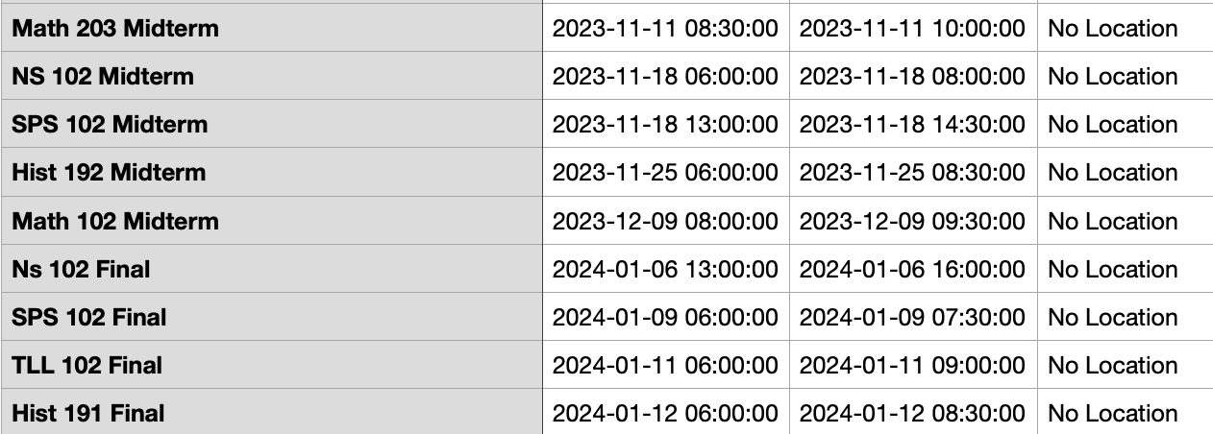
First, I converted .ics file to .csv file so that I am able to work on my exam data with the methods we have learned.
Some example rows from csv file
code

Slide 17
Later, I combine the data’s of exam dates and coffee consumption amount to find whether or not they are correlated. After, since looking only to the exam date is not a healthy option for this case, I tested the correlation up until 5 days ago before the exam. Because the coffee consumption also should increase before the exams since I study.

Slide 18
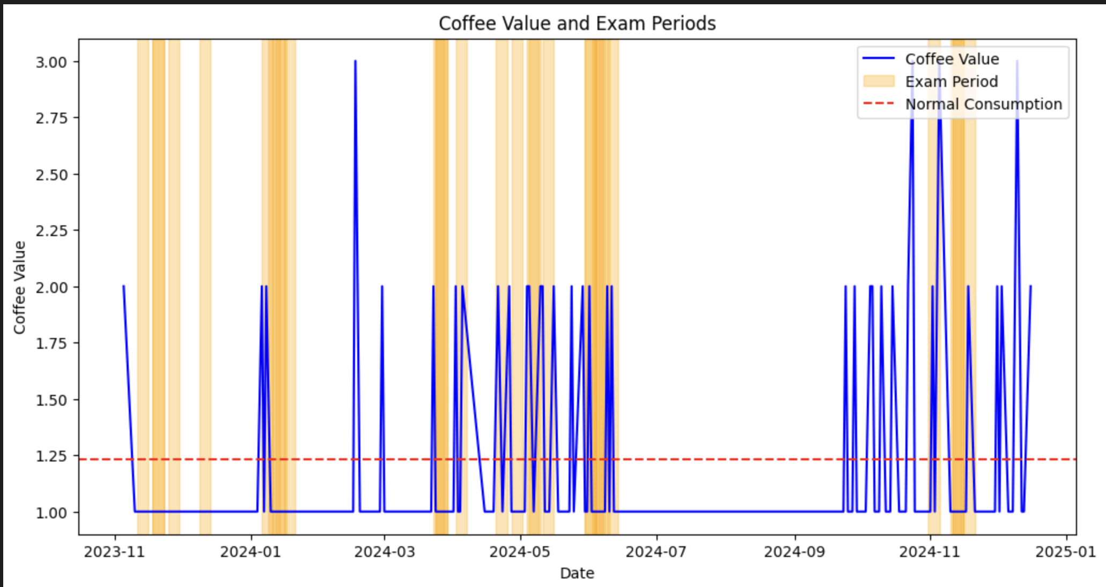
In this graph yellow bars represent Exam dates, red line represents my normal average coffee consumption per day, and the blue lines show the anomalies. Except some days, most of the anomalies are near to the exam dates.
So, this graph confirms my second hypothesis. But, in order to be sure, we have to use hypothesis testing methods.

Slide 19
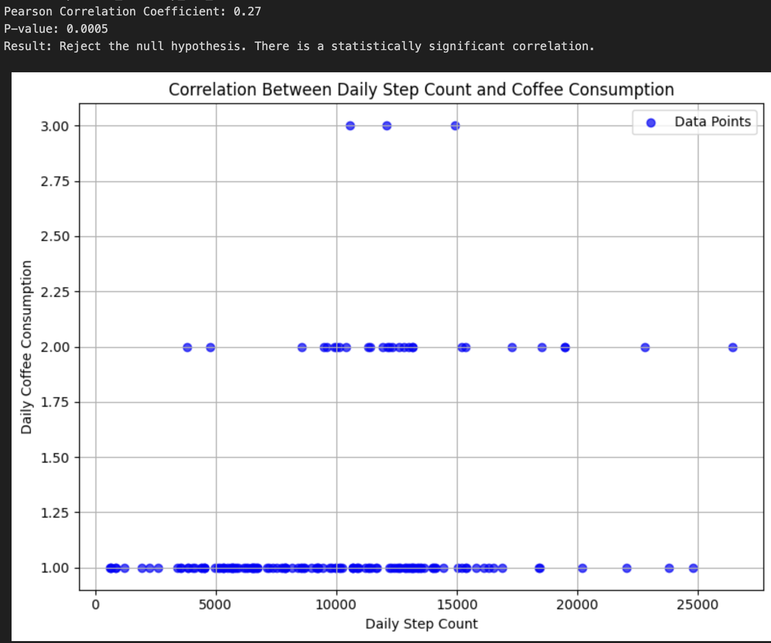

Hypothesis Testing for daily step count and coffee consumption
It is obvious that although my daily coffee consumption increases, my daily step count does not increase with the same ratio. Even, for some cases, it remains the same or decreases. Also, p-value is calculated as 0.0005 which is less than $α$ (0.05). So, I reject my null hypothesis which is “There is my step count and coffee consumptions are correlated.”

Slide 20
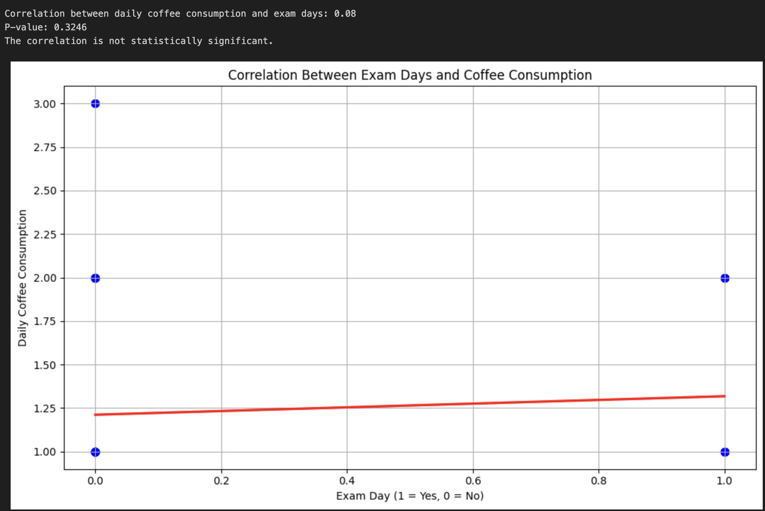

Hypothesis Testing for exam dates and coffee consumption
Here, the p-value which is calculated as 0.3246 is greater than $α$ (0.05). So, I fail to reject my null hypothesis which is ”There is a correlation between my exam dates and my coffee consumption.”

Slide 21
In conclusion, one of my hypothesis is true which is: “My step coffee consumption increases according to exam dates” and my other hypothesis is false which is: “My step count increases according to the average coffee consumption”

Slide 22
I concluded that, although the correlation between my step count and daily coffee consumption is not strongly correlated, there is still a positive correlation but this is not enough to confirm my hypothesis. Also, there is a strong correlation between my exam dates and daily coffee consumption and with p-value test it is confirmed that the null hypothesis is true.

Slide 23
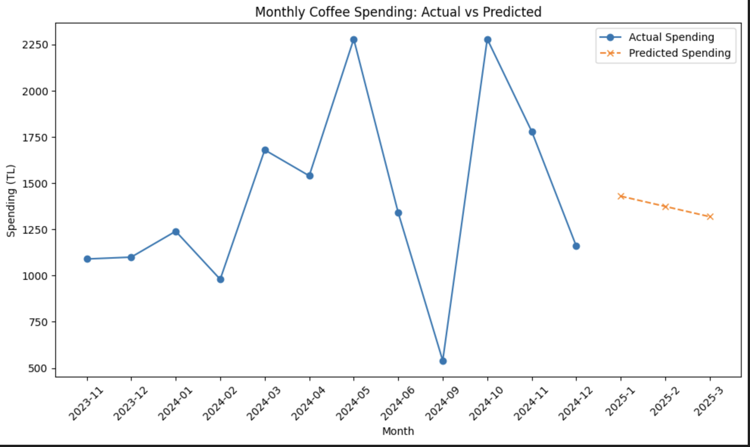
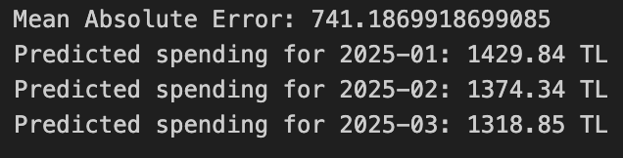
My Regression Model which predicts the coffee consumption in next 3 months

Slide 24
Limitations
I have limited data since I couldn’t find my coffee consumption data before a certain date.
My data in summer has some missing parts.
Places like Starbucks and Coffy can be examined in detail.
Exams and daily step size can be examined more detail and can be tested to see if there is a correlation between them. Also, this can be related to the daily calorie burn.
Future Work

Slide 25
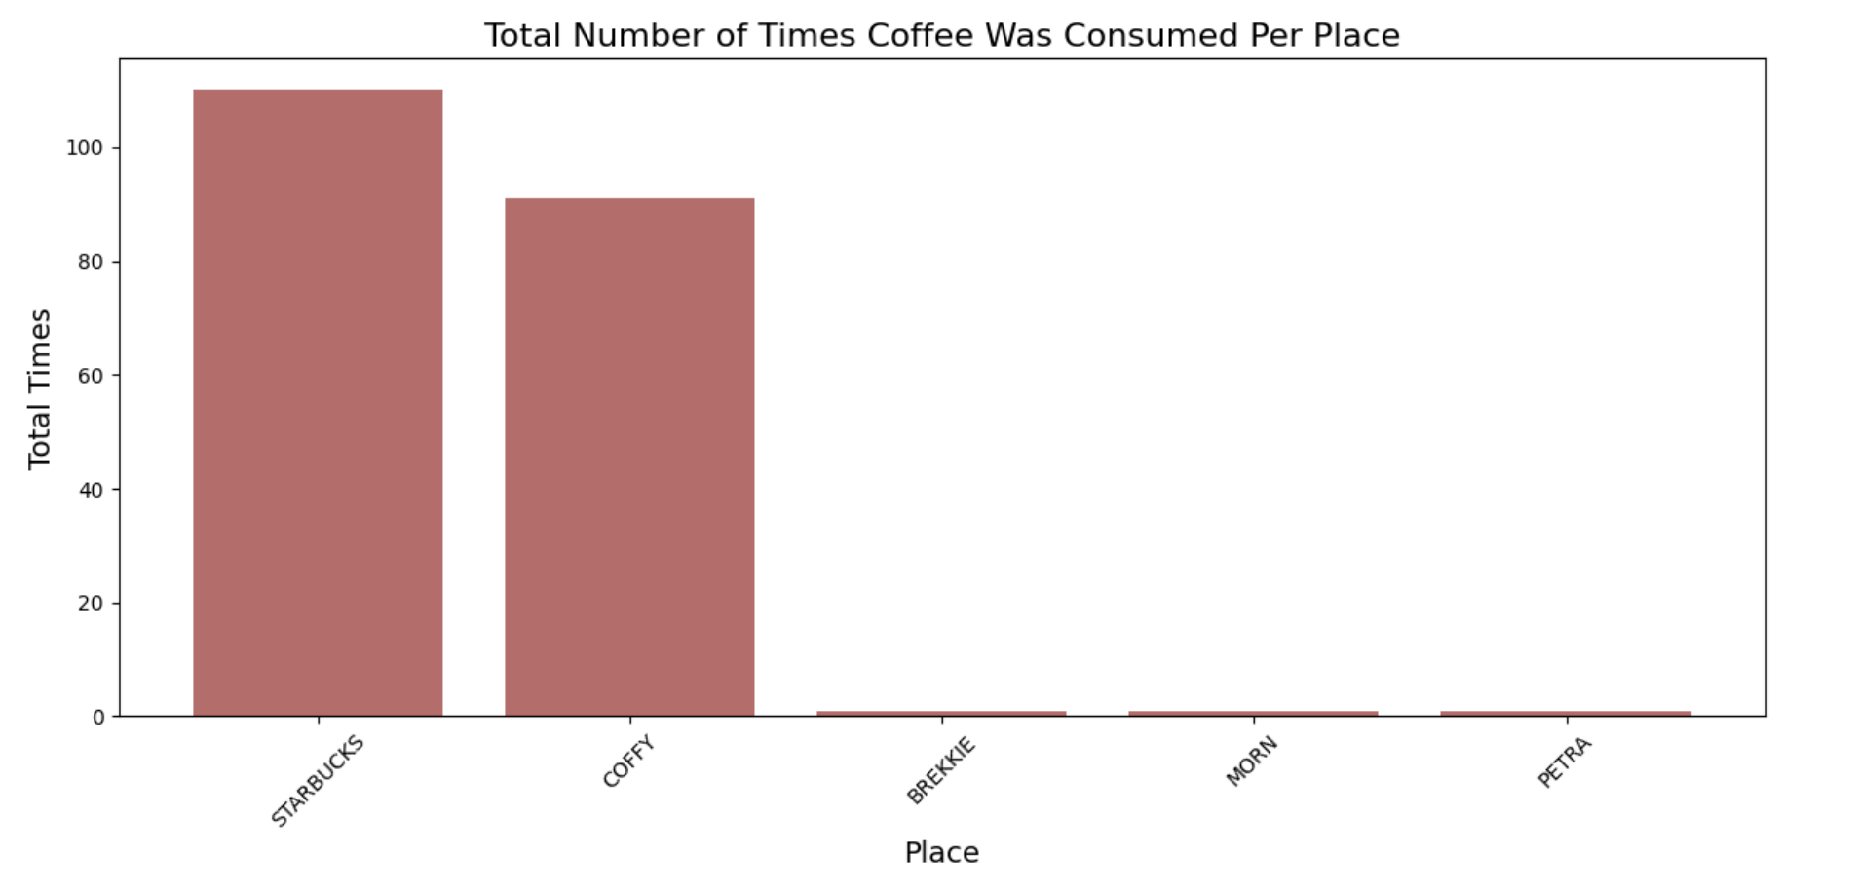
Some additional findings…
It looks like I prefer to buy coffee from Starbucks most of the time

Slide 26
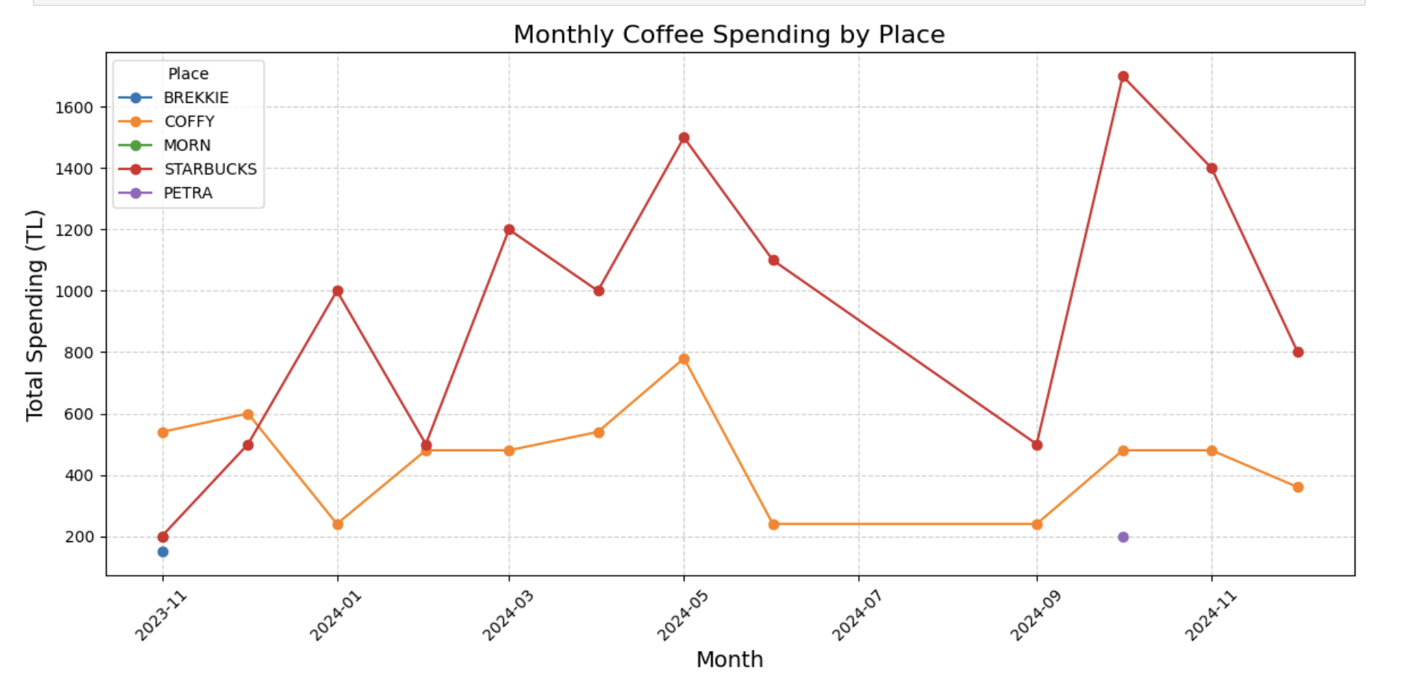
Some additional findings…
Monthly average of my spendings for each places. It can be said that before around 2023-12 I prefer to buy from Coffy, but later I started to prefer Starbucks most of the time.

Slide 27
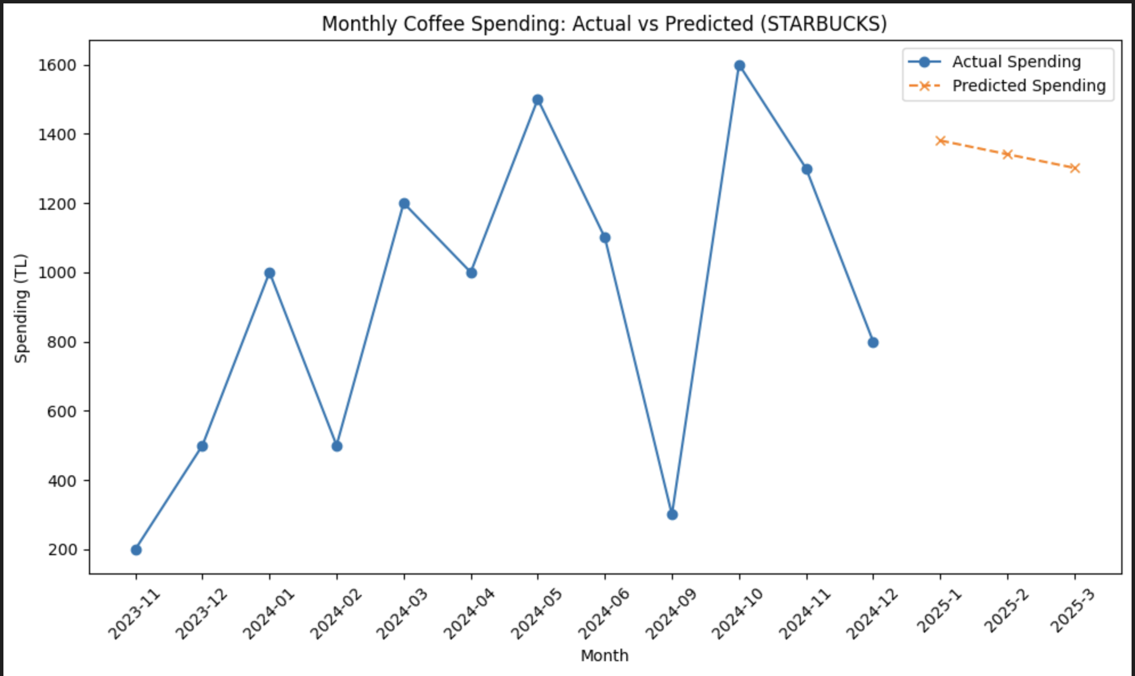
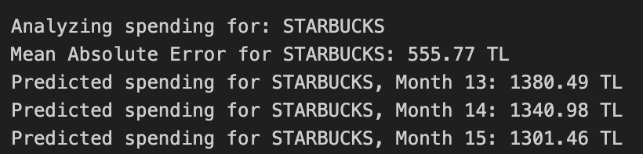
Some additional findings…
Regression model only for Starbucks spendings

Slide 28
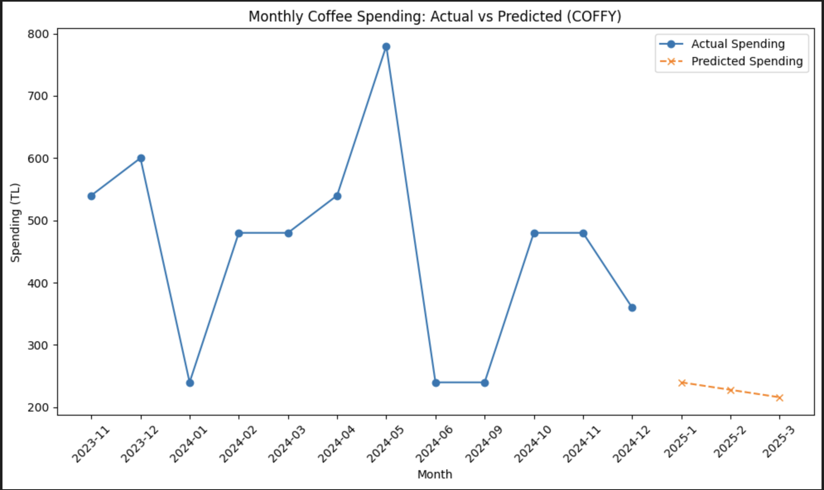
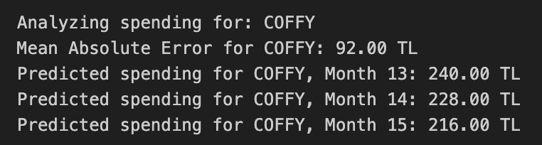
Some additional findings…
Regression Model only for Coffy

Slide 29
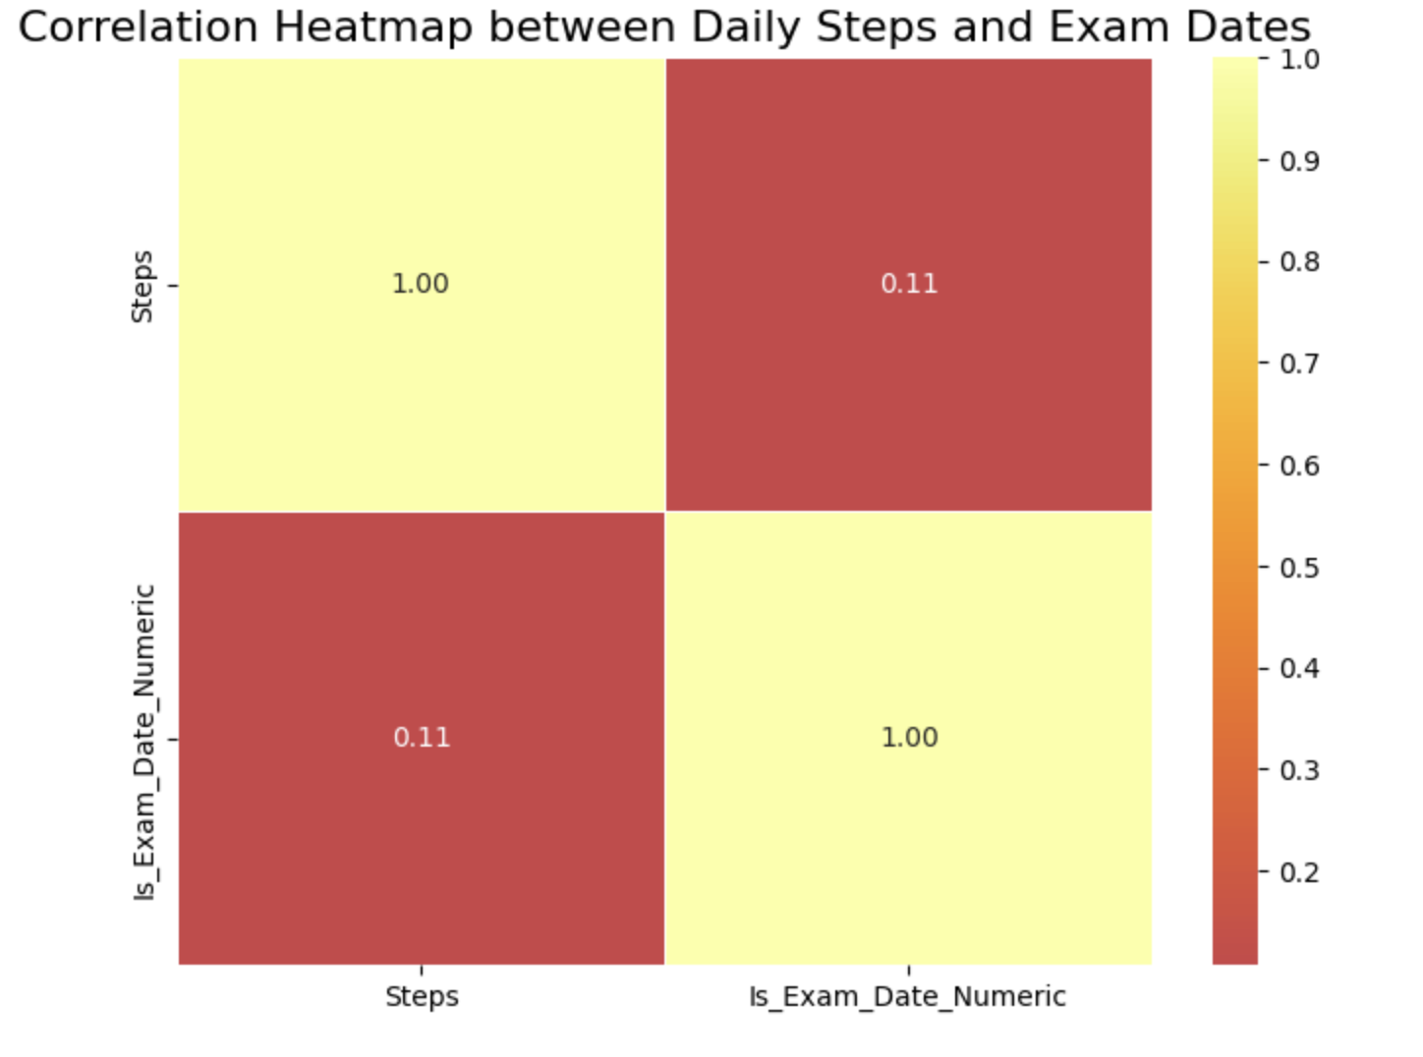
Some additional findings…
There is also a positive but not a very strong correlation between my exam period and daily step count.

Slide 30
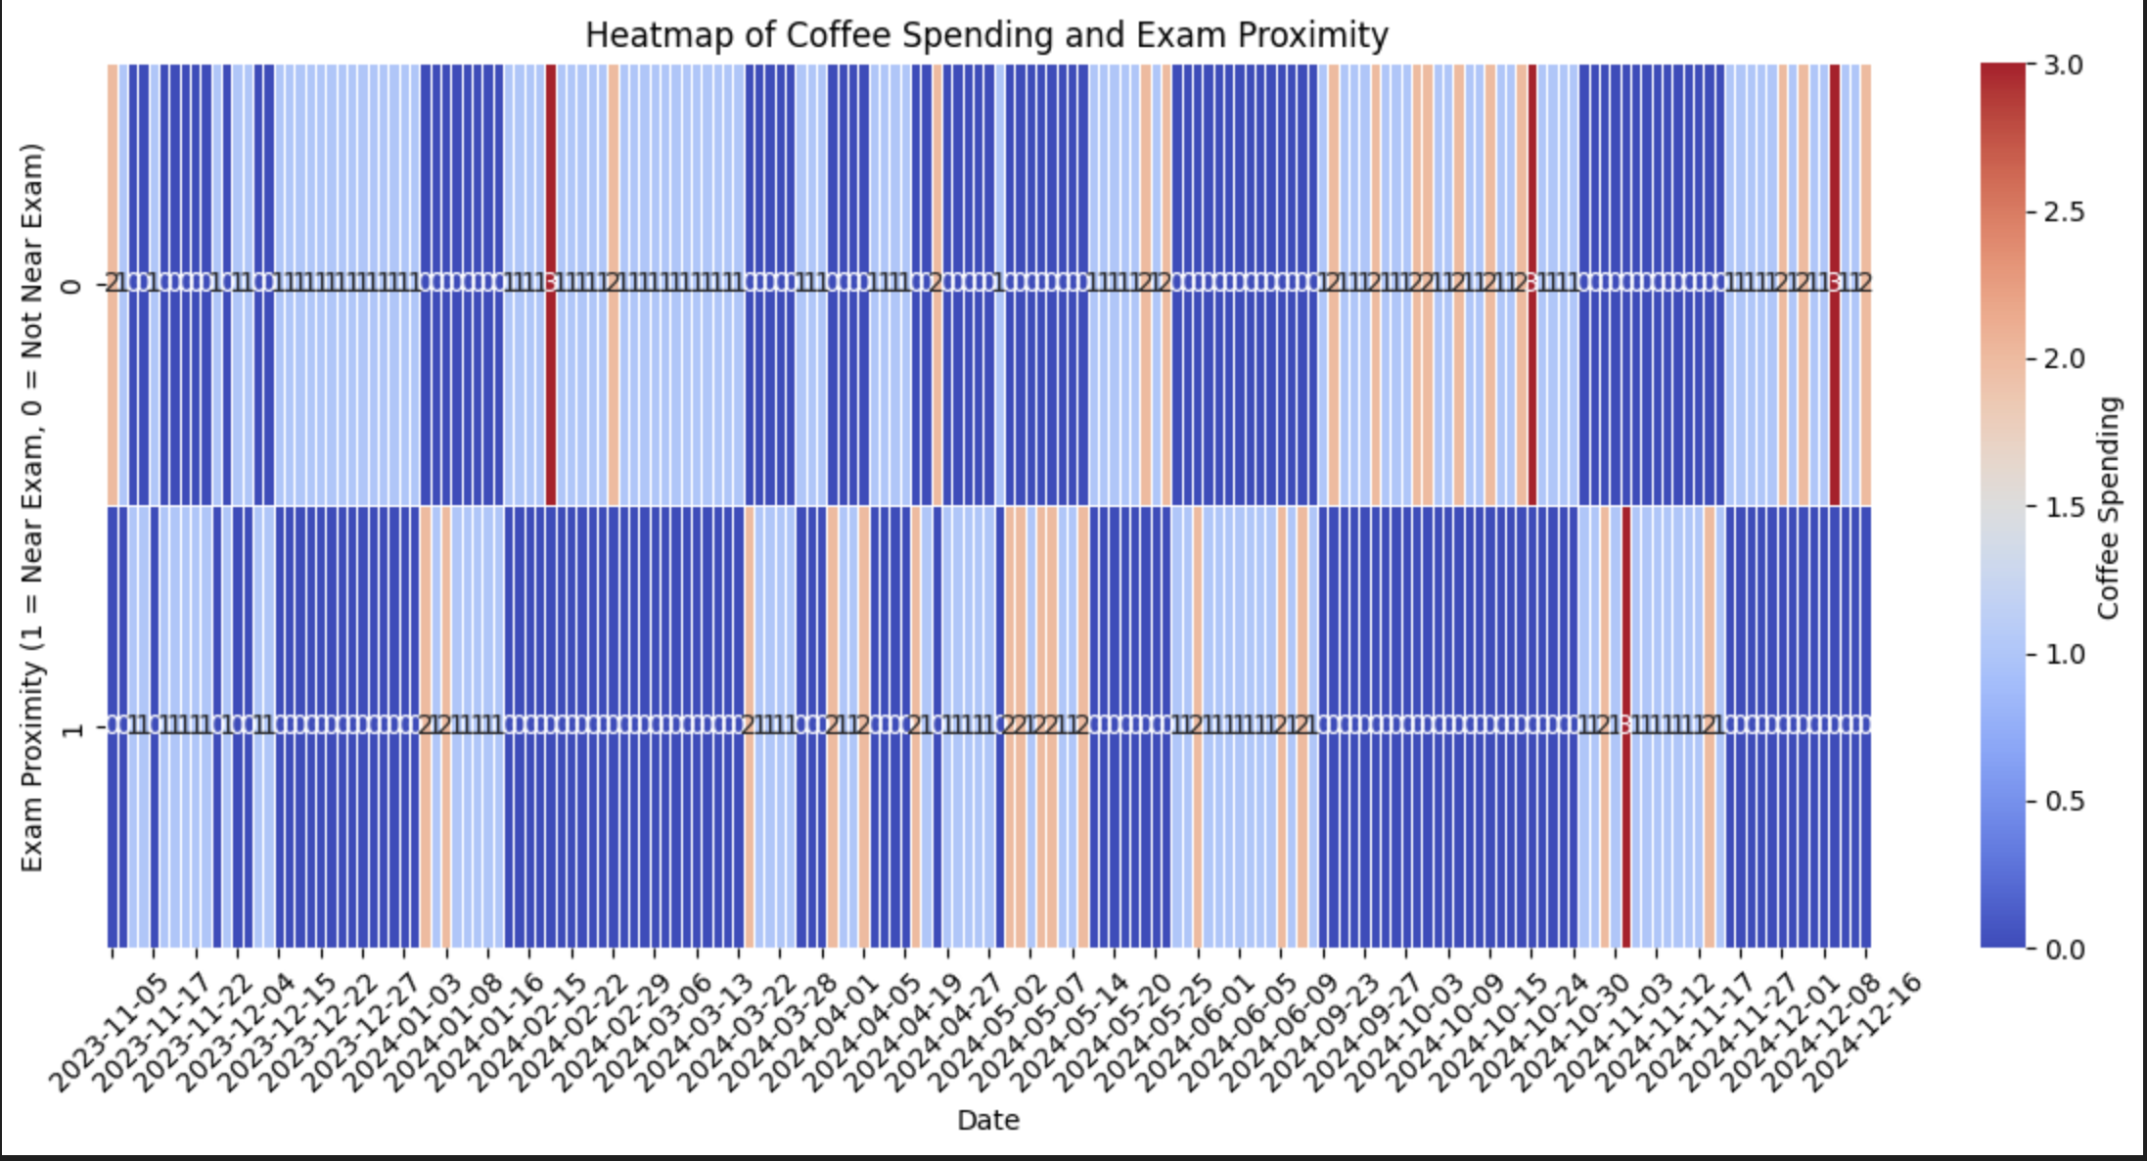
Some additional findings…
A heat map of coffee spending and exam dates. Which again shows the correlation between the exam dates and coffee consumption anomalies and those anomalies amount.

Slide 31
Thank You for your time and patience.

